Slide 1
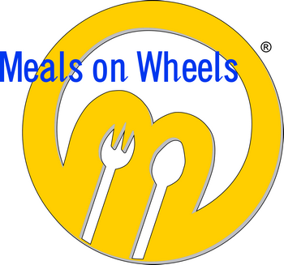
Meals on Wheels of Central Maryland
Walmart Vision Grant
Outcomes Presentation
Stephanie Archer-Smith
Executive Director
August 24, 2012

Slide 2
Walmart Vision Grant
Recognition of Increased Demand on Services:
Growing Population
Growing Need
Sense of Falling Behind

Slide 3
Maryland Region
Growing population:
85 yrs. & older is projected as the fastest growing segment of the population in our region
65 yrs. & over showed a 10% increase in the 2010 census
65 yrs. projected to be 40% in the next 20 years

Slide 4
Maryland Region
Growing need:
Largest demographic living below poverty > 65 yrs. (fixed income; diminished retirement savings)
20% of population have functional limitations or disabilities
13% increase in requests for service

Slide 5
Meals on Wheels of Central Maryland
Sense of Falling Behind:
Aging Equipment: faulty packaging; appearance; food quality
Flat Government Funding with increased cost of food/gas
Diminishing Public Image due to product quality and timeliness

Slide 6
Response to Challenges
Strategic Planning process (2009-2010)
Developed a long-term vision statement to:
establish an infrastructure and business model that will enable us to double the number of clients we serve daily, from 1,500 to 3,000, by 2020

Slide 7
Strategic Goals
Increase efficiency and reduce cost
Shift from non-profit model to business model
Expand reach without increasing cost

Slide 8
Strategic Initiatives
Installation of a new tray line system
Outsourcing kitchen management and meal production
Installation of a new freezer to increase frozen meal capacity

Slide 9
Walmart Vision Grant
Achieved strategic goals 1 & 2 with the installation of two new tray lines
Increase efficiency and reduce cost
Expand reach without increasing cost
TS-50 and TS-25 tray sealers

Slide 10
RTG Tray Lines
TS-50 (entree selections) and TS-25 (cold cupping) tray sealers
capable of production speed of up to 50 trays per minute
quick change plate system: easy production changeovers & multiple container sizes

Slide 11
Vision Grant Impact
Increased Efficiency
Increased meal production: An additional three more meals per minute (a total of 180 more meals per hour)
Less time wasted on the back end (leaks/spills/repackaging)

Slide 12
Vision Grant Impact
Reduced Cost
Cost savings on trays: a reduction of $.052 per tray or from $.235/tray to $.175/tray
Labor savings: $6,240/yr. attributable to enhanced automation capabilities of the equipment

Slide 13
Vision Grant Impact
Improved Customer Satisfaction
Meals are aesthetically more appealing
Increased Volunteer Satisfaction
Less frustration and increased pride in product
More timely delivery

Slide 14
Vision Grant Impact
Improved Public Image
Positive responses from private foundations
Knott Foundation Match
Bearman Foundation Freezer Grant
Increased Board Commitment: Knott Challenge

Slide 15
LESSONS LEARNED
Team approach and clear ongoing communication are key.
Invite positive, constructive differences of opinion among your team when conceptualizing and developing major projects.
Realize the importance of “surveying the field,” (feasibility of frozen meals)
Prepare for the unexpected: staff turnover

Slide 16
Looking Forward
Poised and system-ready
new tray line’s meal production capacity will enable us to serve an additional 300 clients a day without adding to our labor costs
machine tight sealing capability currently allows us to produce limited frozen meals
offers us more flexibility in responding to RFPs in the future.

